Slide 1

Facial Emotion Analysis for Instant Audience Feedback
Department of Computer Science and Engineering
Team Members: VINAKOLLU GOKUL, DEPA SAI CHARAN REDDY, NAGULAPATI YASHWANTH REDDY, KATTA LAKSHMI NARASIMHA.
Roll No:2010030181
2010030038
2010030235
2010030458
Major Domain: Deep Learning.
Project Supervisor: Dr. Rama Rao

Slide 2
Problem Statement
This project addresses the critical need for reliable and real-time expression detection in crowded scenes, such as public spaces, classrooms, or workplaces. Accurate emotion analysis has diverse applications, from improving human-computer interaction to enhancing emotional awareness in social contexts.
The project aims to address this challenge by harnessing the power of computer vision and deep learning techniques, specifically leveraging the Keras framework. The primary focus is on developing a robust system capable of detecting and analyzing emotions on the faces of multiple individuals in real-time during presentations. By implementing a comprehensive solution that accurately identifies a range of emotions, including happiness, surprise, sadness, and more, presenters will gain valuable insights into the audience's reception and engagement levels .

Slide 3
Problem Solution
Develop a robust system using computer vision and deep learning techniques, specifically leveraging the Keras framework, to achieve real-time detection and analysis of emotions on multiple faces during presentations.
Data-driven Approach:
Collect diverse facial expressions in real time datasets.
Preprocess and annotate the dataset for effective model training.
Model Development:
Implement a Convolutional Neural Network (CNN) using the Keras framework.
Explore pre-trained models for feature extraction.

Slide 4
Significance
Technology has transformed traditional educational systems around the globe. Integrating digital learning tools into classrooms offers students better opportunities to learn efficiently and allows the teacher to transfer knowledge more easily. In recent years, there have been many improvements in smart classrooms. For instance, the integration of facial emotion recognition systems (FER) has transformed the classroom into an emotionally aware area using the power of machine intelligence and IoT.
Recently, FER systems are used in several domains like robotics, security, psychology, etc; thus, over time many researchers suggest new performant FER approaches.
The input of this system is the images from a FER database. Those images are pre-processed in a way to match the input size of the network, then, adequate algorithms are used to detect area of the face properly and extract the main features that help the network learn from training data. The final step is to classify results according to the database labels. Thousands of articles have been written on this subject, but only a few of them have applied FER systems to smart classrooms.

Slide 5
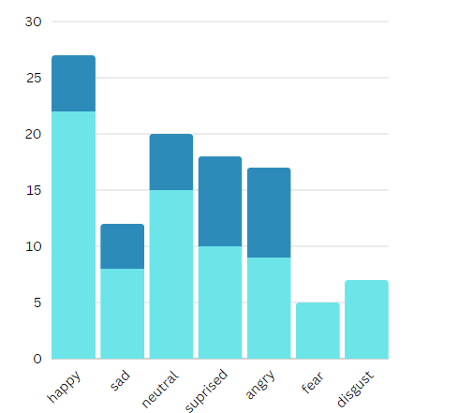
Objective
Real-time Emotion Detection:
Develop a real-time facial expression detection model using Keras.
Enable simultaneous analysis of multiple faces in crowded settings.
User-Friendly Interface:
Design an intuitive interface for presenters to visualize real-time emotion analytics.
Display detected emotions and relevant statistics for actionable insights.
Optimized Performance:
Fine-tune the model for optimal accuracy in identifying a range of emotions.
Deploy and optimize the system for scalability in classrooms, workplaces, and public spaces.
Live video recording:
Live video recording option where it gives the overall feedback of that particular time.

Slide 6
Scope of the study
The primary scope of this project is to establish a model that can classify seven basic emotions: happy, sad, surprise, angry, disgust, neutral, and fear and to achieve the accuracy better than the baseline.
The project will develop a robust system capable of real-time emotion recognition from the facial expressions of audience members. The system will analyze subtle cues such as smiles, frowns, and raised eyebrows to gauge the audience's emotional engagement and comprehension levels. The captured emotional data will be translated into meaningful insights, enabling presenters to adapt their delivery in response to the audience's reactions.
Adding new features like it shouldn’t be counting the same faces again and storing the into the database .

Slide 7
Convolutional Neural Network
Methodology:
CNNs are specialized neural networks designed for processing structured grid data, particularly well-suited for tasks like image and video analysis.
Utilizes convolutional layers to apply convolutional operations, allowing the network to learn local patterns and features in the input data.
Widely used in computer vision tasks such as image classification, object detection, and facial recognition.
The CNN generating classifications take place when an image is taken and classified in the manner described below: With a trained network, it is possible to use these functions to classify images never "seen" by the network before (zero bias) with a surprisingly high degree of accuracy.
The method views the input image as a pixel matrix .This matrix will go through a series of convolution filters, pooling, and functions like softmax, which classifies an object with probabilistic values between 0 and 1.

Slide 8
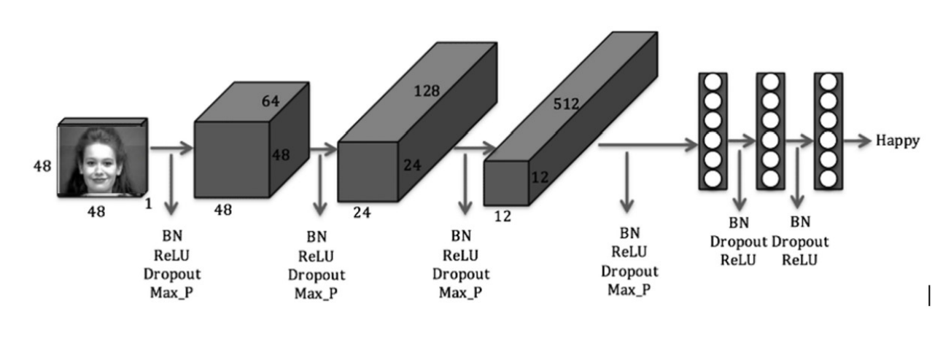
CNN Model

Slide 9
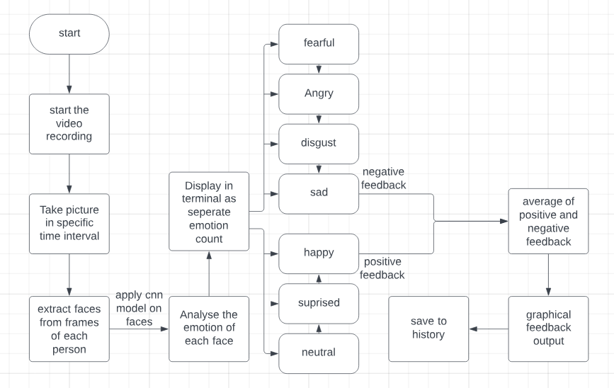
System Architecture

Slide 10
MERITS
Immediate Feedback:
Real-time Responses: Facial expressions provide instant feedback, allowing for immediate adjustments and responses during interactions.
Enhanced Communication:
Complementary to Verbal Feedback: Facial expressions complement verbal feedback, adding layers to communication and reducing ambiguity.
Engagement and Attention:
Increased Engagement: People tend to pay attention to facial expressions, leading to increased engagement and focus during feedback sessions.

Slide 11

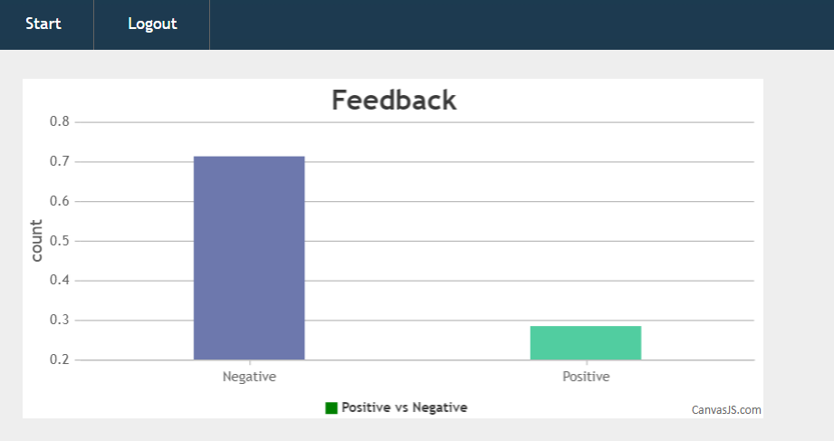
output

Slide 12
References
NO. | AUTHORS | TITLE | Volume No. | YEAR
1. | Wafa Mellouk a, Wahida Handouzi a | Facial emotion recognition using deep learning: review and insights | Volume 107 | 2020
2. | Shan Li, Weihong Deng | Deep Facial Expression Recognition: A Survey | Volume: 13 | 2022
3. | PeterBurkert,felix Trier, Muhammad Zeshan Afzal, Andreas Dengel | DeXpression: Deep Convolutional Neural Network for Expression Recognition | Volume 2 | 2016
4. | D Y Liliana | Emotion recognition from facial expression using deep convolutional neural network | Volume 18 | 2018
5. | Shima Alizadeh, Azar Fazel | Convolutional Neural Networks for Facial Expression Recognition | Not mentioned | 2017

Slide 13
NO. | AUTHORS | TITLE | Volume No. | YEAR
6. | Moe Moe Htay, Zin Mar Win | Survey on Emotion Recognition Using Facial expression | Volume 33 | 2019
7. | Heechul Jung, Sihaeng Lee, Sunjeong Park, Byungju Kim, Junmo Kim, Injae Lee, Chunghyun Ahn | Development of deep learning-based facial expression recognition system | Volume: 13 | 2015
8. | ] Yong Li, Jiabei Zeng, Shiguang Shan, Xilin Chen | Occlusion aware facial expression recognition using CNN with attention mechanism | Volume 14 | 2018
9. | ]Nabil Tahmidul Karim, Sanjana Jain, Jednipat Moonrinta, Matthew N. Dailey, Mongkol Ekpanyapong | Customer and Target Individual Face Analysis for Retail analytics | Volume 18 | 2018
10. | D. Bamman and N. A. Smith | Contextualized Sarcasm Detection on Amazon Product review | Volume 5 | 2015

Slide 14
NO. | AUTHORS | TITLE | Volume No. | YEAR
11. | M. Liu, Y. Li, W. Xu and L. Liu | Automated Essay Feedback Generation and Its Impact on Revision | Volume 10 | 2017
12. | S. L. Happy, A. Dasgupta, P. Patnaik and A. Routray | Automated Alertness and Emotion Detection for Empathic Feedback during e-Learning | Volume: 13 | 2015
13. | Y. Zhan and M. S. Hsiao | A Hybrid Approach for Automatic Feedback Generation in Natural Language Pro- gramming | Volume 14 | 2022
14. | Si Miao, Haoyu Xu, Zhenqi Han, Yongxin Zhu | Rec- ognizing Facial Expressions Using a Shallow Convolutional Neural Network | Volume 18 | 2019
15. | Lin, W., Li, C | Review of Studies on Emotion Recognition and Judgment Based on Physiological Signals. | Volume 5 | 2023

Slide 15
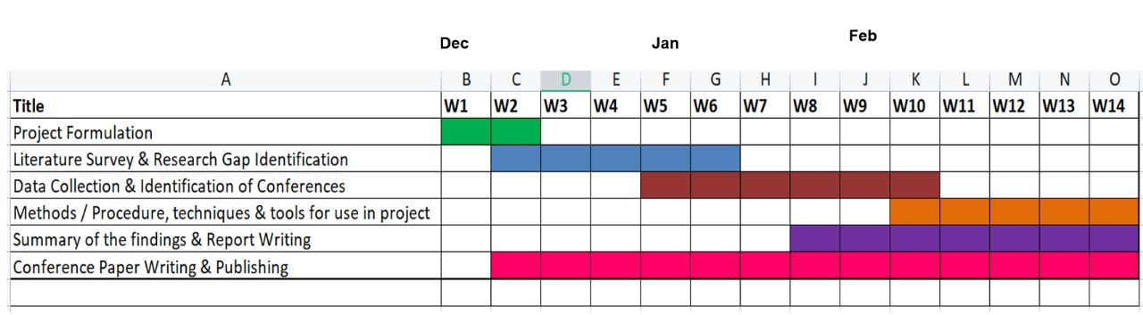
PROJECT PLAN – GANTT CHART
Mar

